Slide 1
Committee Meeting
Cassidy Northway
PhD Candidate
Nov 25, 2025

Slide 2
Agenda
Review Thesis Question
Present Project 1 – Total Body Blood Flow Model
Present Preliminary Results of Project 2 – Heterogeneity of Dose: Sweeping Co-60 TBI
Discuss remainder of Project 2 and Project 3
Discuss publications and body of thesis
Questions and Discussions

Slide 3
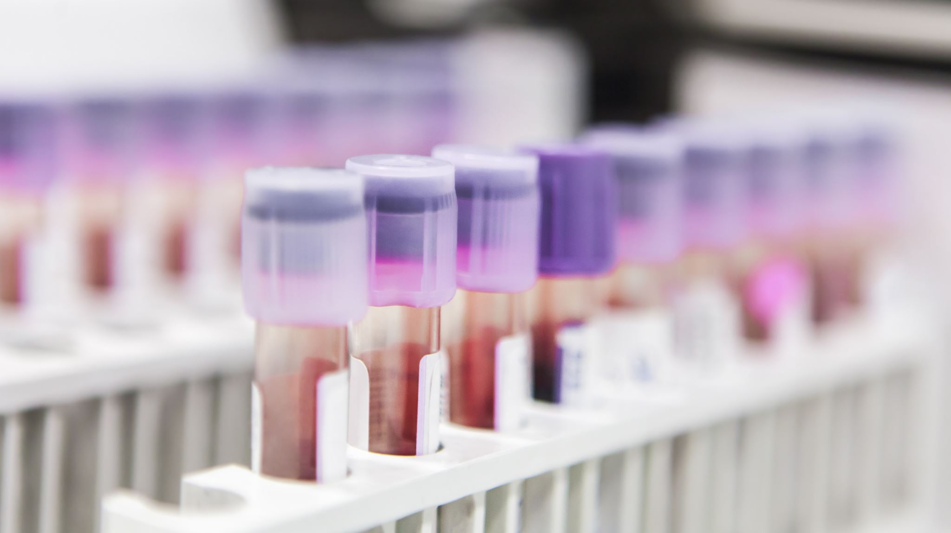
How heterogenous is the dose delivered to the circulating blood volume during TBI?

Slide 4
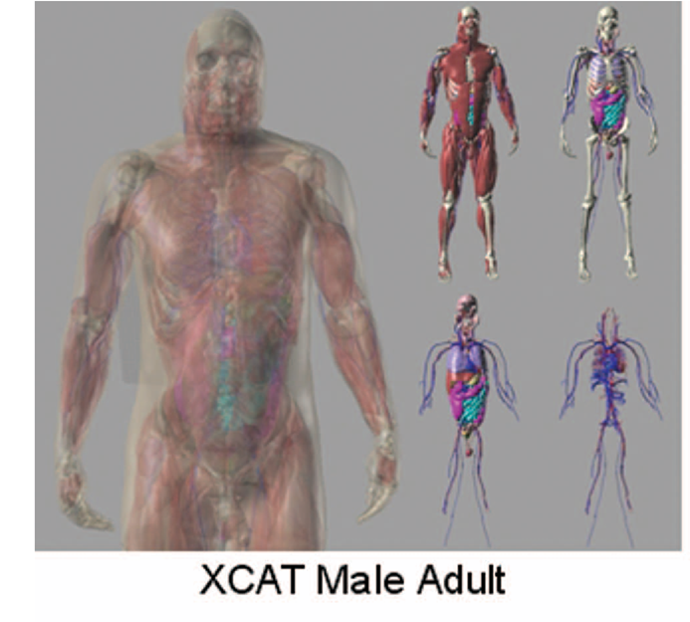
Thesis Proposal: Reviewed
In-silico, track the flow of blood voxels through a whole-body phantom undergoing TBI, calculate their cumulative dose, and compare the dose to the voxels.
Whole Body Phantom (4D XCAT) model will unite a blood flow model and Monte Carlo (MC) Simulations to determine dose.
Model the following delivery methods in MC:
Sweeping Co-60
Extended POP
VMAT TBI
Notes:
Segars, William Paul, Jason Bond, John P. Frush, Sylvia Hon, Christopher P. Eckersley, Cameron H. Williams, Jianqiao Feng, Daniel Jacob Tward, J. Tilak Ratnanather, M. I. Miller, Donald P. Frush and Ehsan Samei. “Population of anatomically variable 4D XCAT adult phantoms for imaging research and optimization.” Medical physics 40 4 (2013): 043701 .

Slide 5
What is the heterogeneity of dose to the circulating blood volume during TBI?
Presented at COMP 2025
Determine dose deposition in time
Track blood flow through the body
Model various TBI treatments

Slide 6
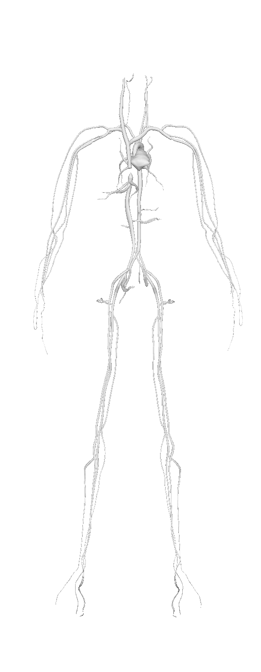
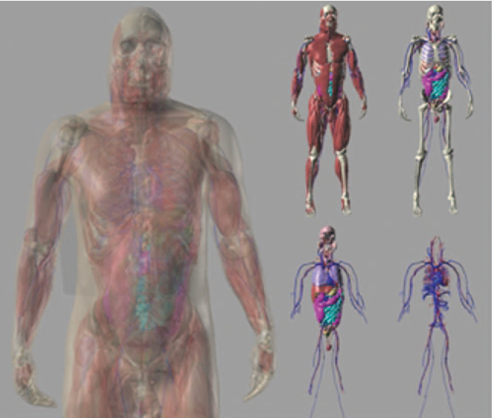
XCAT Phantom
Geometric
n Information
Connectivity nnMap
Segars, W P et al. “4D XCAT phantom for multimodality imaging research.” Medical physics vol. 37, no. 9, 2010.

Slide 7
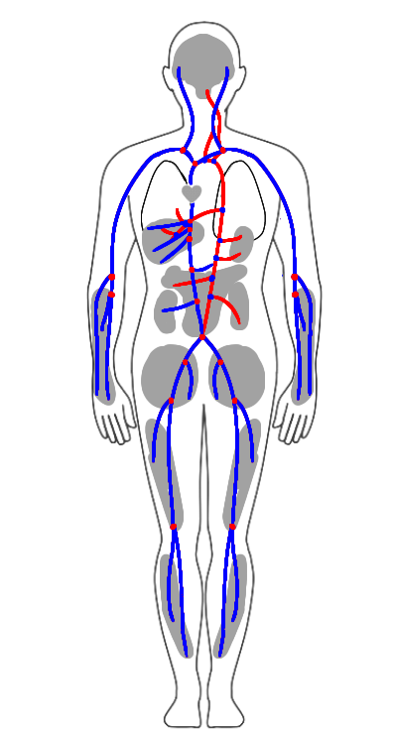
XCAT Phantom
Geometric
n Information
Connectivity nnMap
Segars, W P et al. “4D XCAT phantom for multimodality imaging research.” Medical physics vol. 37, no. 9, 2010.
Notes:
Want to add actual mesh subset image from 3d mesh, also indicate what info we actually extracted from the mesh files for the purposes of the sim

Slide 8
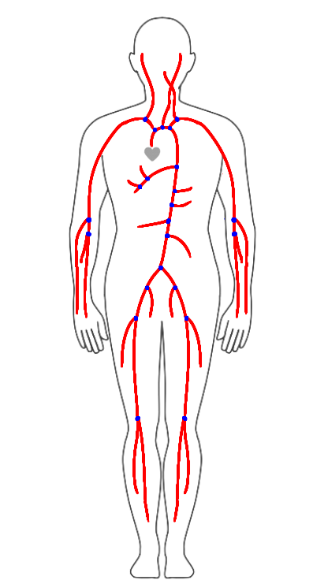
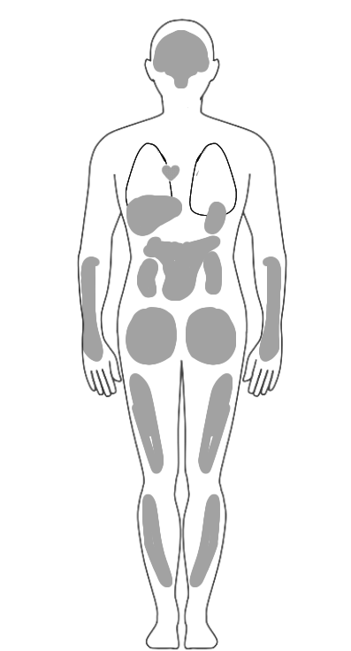
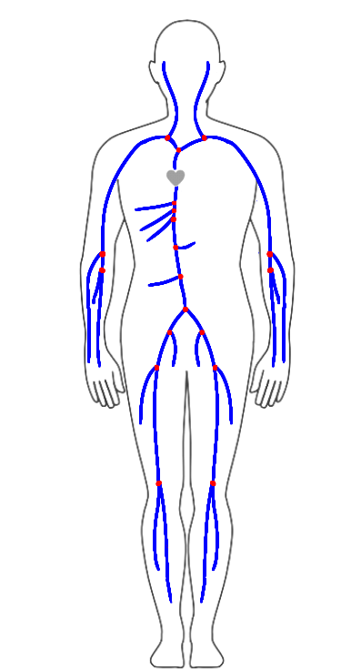
Model Components
=
+
+

Slide 9


Model Components – Systemic Arteries
$$Q \left(x_{i},t\right)$$
Alastruey J, Parker KH, Sherwin SJ. Arterial pulse wave haemodynamics. In Anderson S, editor, 11th International Conference on Pressure Surges. Lisbon: Virtual PiE Led t/a BHR Group. 2012. p. 401-443.

Slide 10
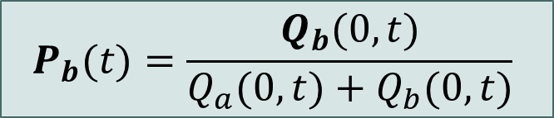
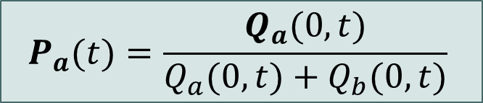
Model Components – Systemic Arteries
$$Q \left(x_{i},t\right)$$
$$P_{a}(t)=\frac{Q_{a}(0,t)}{Q_{a}(0,t)+Q_{b}(0,t)}$$
$$P_{b}(t)=\frac{Q_{b}(0,t)}{Q_{a}(0,t)+Q_{b}(0,t)}$$
Alastruey J, Parker KH, Sherwin SJ. Arterial pulse wave haemodynamics. In Anderson S, editor, 11th International Conference on Pressure Surges. Lisbon: Virtual PiE Led t/a BHR Group. 2012. p. 401-443.

Slide 11
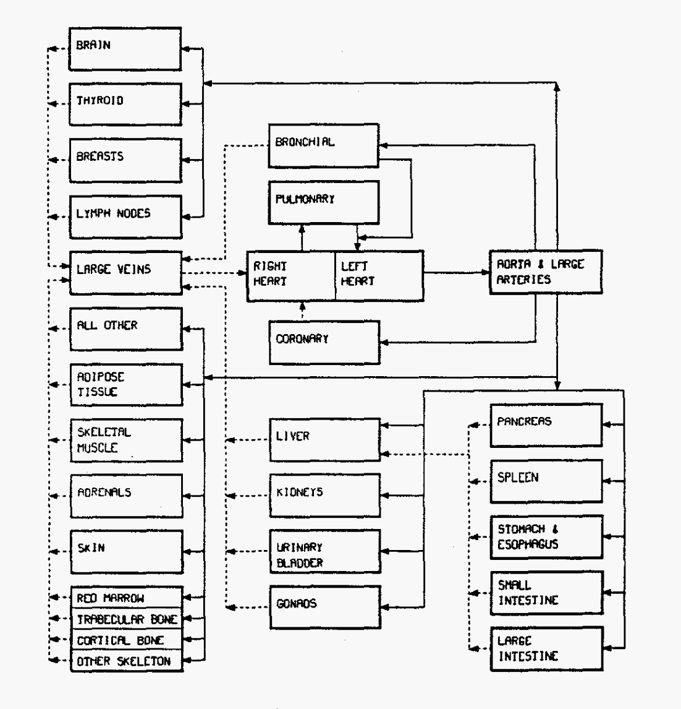
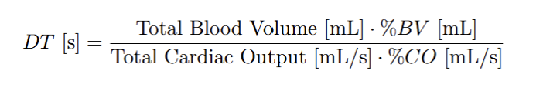
Model Components - Compartments
Dwell Time
Leggett RW, Williams LR. A proposed blood circulation model for Reference Man. Health Phys. 1995 Aug;69(2):187-201.
Notes:
What happens when the BV reaches a compartment,

Slide 12
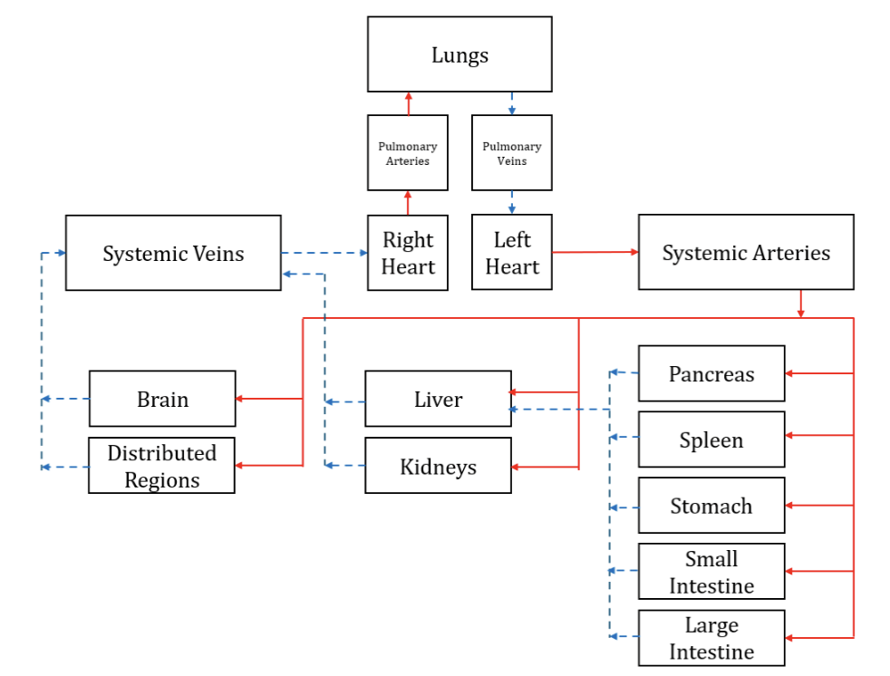
Model Components - Compartments
Dwell Time
Leggett RW, Williams LR. A proposed blood circulation model for Reference Man. Health Phys. 1995 Aug;69(2):187-201.

Slide 13
Model Components - Compartments
Dwell Time
Leggett RW, Williams LR. A proposed blood circulation model for Reference Man. Health Phys. 1995 Aug;69(2):187-201.

Slide 14
Model Components – Systemic Veins
Doppler ultrasound and MRI flowrate data
Notes:
1D modelling, what is it, how are vessels connected to each other, how does bv move down the vessels starting at the heart.

Slide 15
Model Components – Systemic Veins
Doppler ultrasound and MRI flowrate data
Notes:
1D modelling, what is it, how are vessels connected to each other, how does bv move down the vessels starting at the heart.

Slide 16
Model Tuning
Blanco, P.J., Watanabe, S.M., Dari, E.A. et al. Blood flow distribution in an anatomically detailed arterial network model: criteria and algorithms. Biomech Model Mechanobiol 13, 1303–1330 (2014).
Notes:
What we used to determine the initial estimates, how we tuned the values and the resulting BV dist

Slide 17
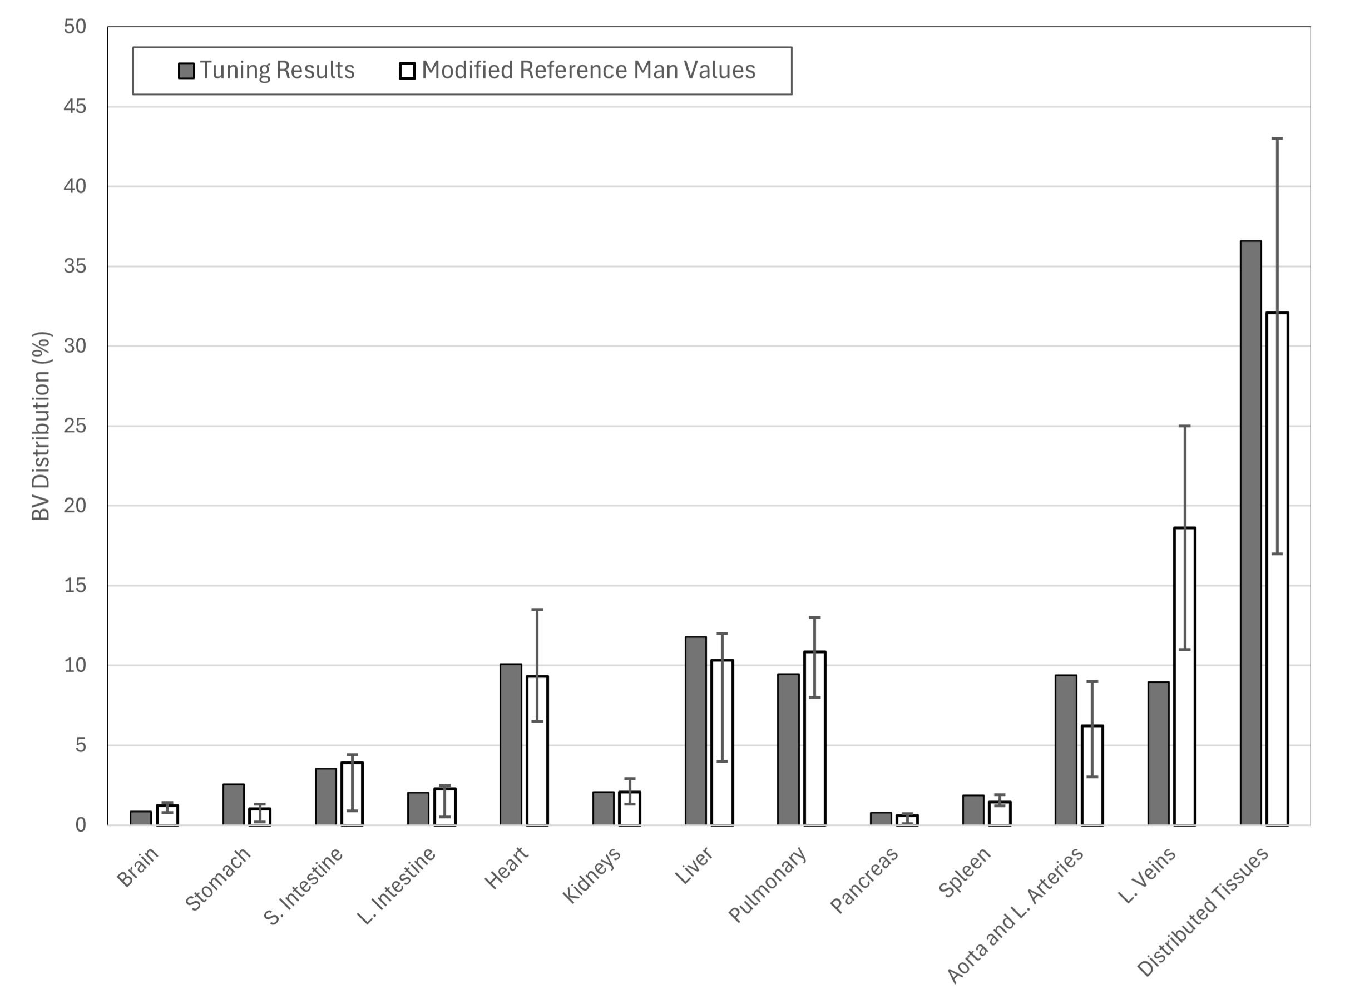
Model Tuning
Notes:
What we used to determine the initial estimates, how we tuned the values and the resulting BV dist

Slide 18
Model Tuning
Notes:
Heart compressed to one unit as opposed to multiple chambers
Spending great blood pool in veins. Compare avg transit time to test whether this is a sig issue.

Slide 19

Model Tuning – Mean Return Time
Shin J, Xing S, McCullum L, Hammi A, Pursley J, Correa CA, Withrow J, Domal S, Bolch W, Paganetti H, Grassberger C. HEDOS-a computational tool to assess radiation dose to circulating blood cells during external beam radiotherapy based on whole-body blood flow simulations. Phys Med Biol. 2021 Aug 3;66(16)
Notes:
Heart compressed to one unit as opposed to multiple chambers
Spending great blood pool in veins. Compare avg transit time to test whether this is a sig issue.

Slide 20
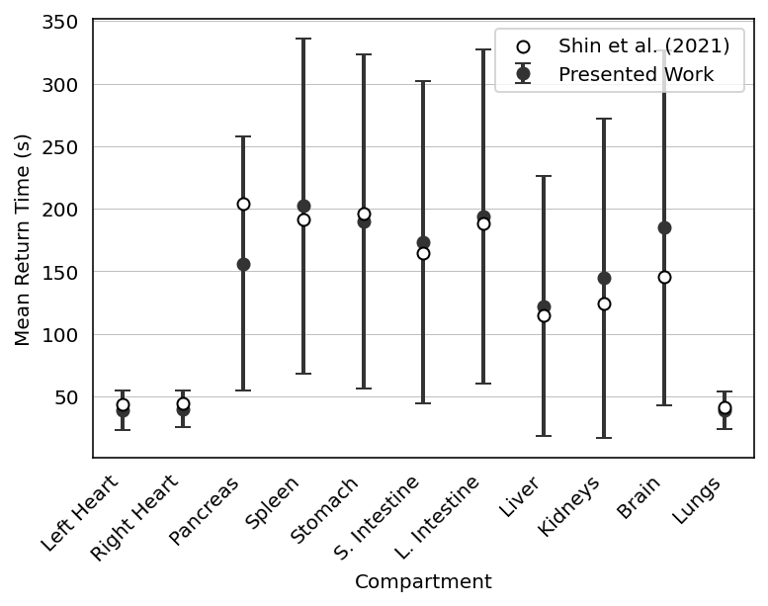
Model Tuning – Mean Return Time
Shin J, Xing S, McCullum L, Hammi A, Pursley J, Correa CA, Withrow J, Domal S, Bolch W, Paganetti H, Grassberger C. HEDOS-a computational tool to assess radiation dose to circulating blood cells during external beam radiotherapy based on whole-body blood flow simulations. Phys Med Biol. 2021 Aug 3;66(16)
Notes:
Heart compressed to one unit as opposed to multiple chambers
Spending great blood pool in veins. Compare avg transit time to test whether this is a sig issue.

Slide 21
What is the heterogeneity of dose to the circulating blood volume during TBI?
Presented at COMP 2025
Determine dose deposition in time
Track blood flow through the body
Model various TBI treatments

Slide 22
Determining Dose as Function of Time
Monte Carlo Simulations
egsNRC: In-house modified DOSXYZnrc enables spatial-temporal dose deposition calculations
Su, S., Atwal, P., Lobo, J., Duzenli, C., & Popescu, I. A. (2021). A new DOSXYZnrc method for Monte Carlo simulations of 4D dose distributions. Physics in Medicine & Biology, 66(24), 245014.

Slide 23
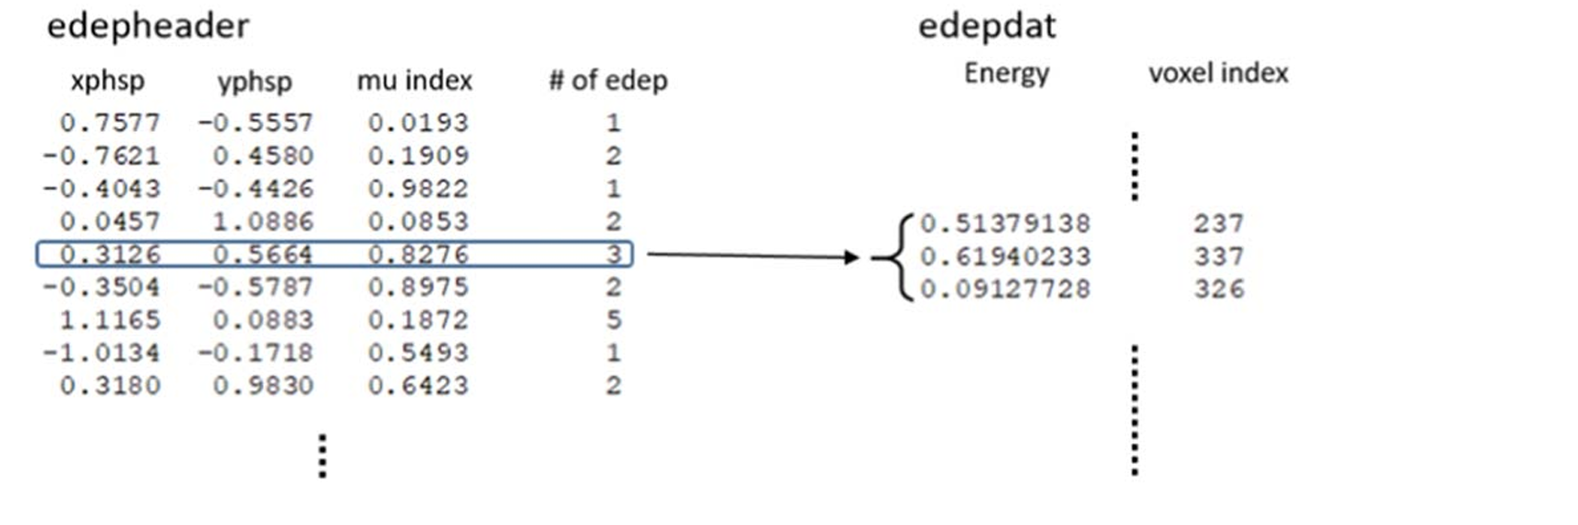
Determining Dose as Function of Time
Monte Carlo Simulations
egsNRC: In-house modified DOSXYZnrc enables spatial-temporal dose deposition calculations
Su, S., Atwal, P., Lobo, J., Duzenli, C., & Popescu, I. A. (2021). A new DOSXYZnrc method for Monte Carlo simulations of 4D dose distributions. Physics in Medicine & Biology, 66(24), 245014.

Slide 24
Determining Dose as Function of Time
Monte Carlo Simulations
egsNRC: In-house modified DOSXYZnrc enables spatial-temporal dose deposition calculations
Su, S., Atwal, P., Lobo, J., Duzenli, C., & Popescu, I. A. (2021). A new DOSXYZnrc method for Monte Carlo simulations of 4D dose distributions. Physics in Medicine & Biology, 66(24), 245014.

Slide 25
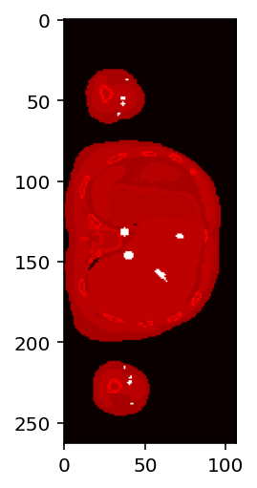
Determining Dose as Function of Time
Monte Carlo Simulations
egsNRC: In-house modified DOSXYZnrc enables spatial-temporal dose deposition calculations
Su, S., Atwal, P., Lobo, J., Duzenli, C., & Popescu, I. A. (2021). A new DOSXYZnrc method for Monte Carlo simulations of 4D dose distributions. Physics in Medicine & Biology, 66(24), 245014.

Slide 26
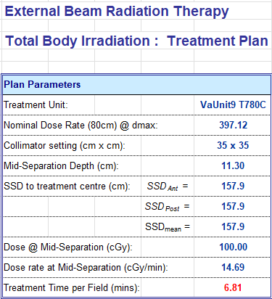
Converting Data: MU to time
For Co-60: treatments are not planned as a function of MU but of time
During treatment planning we determine the min/field
For MC simulation everything is scaled from [0,1] MU.
Trivial to convert from MU to time
Burns, L., Teke, T., Popescu, I. A., & Duzenli, C. (2019). Monte Carlo Dosimetry of Organ Doses from a Sweeping-Beam Total Body Irradiation Technique: Feasibility and First Results. In L. Lhotska, L. Sukupova, I. Lacković, & G. S. Ibbott (Eds.), World Congress on Medical Physics and Biomedical Engineering 2018 (pp. 421–427). Springer.
Notes:
Uncert 0.4%, ran 10 sims

Slide 27
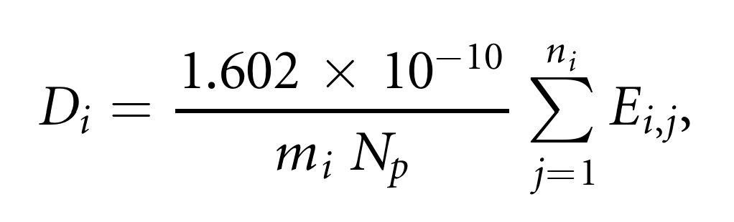
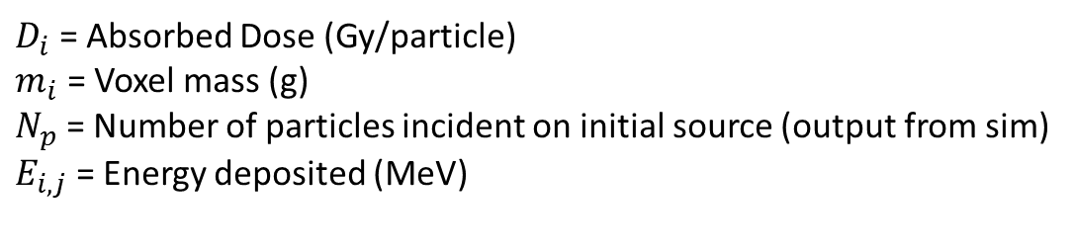
Converting Data: Energy Deposited to Dose
$D_{i}$ = Absorbed Dose (Gy/particle)
$m_{i}$ = Voxel mass (g)
$N_{p}$ = Number of particles incident on initial source (output from sim)
$E_{i,j}$ = Energy deposited (MeV)
Su, S., Atwal, P., Lobo, J., Duzenli, C., & Popescu, I. A. (2021). A new DOSXYZnrc method for Monte Carlo simulations of 4D dose distributions. Physics in Medicine & Biology, 66(24), 245014.

Slide 28
Converting Data: Energy Deposited to Dose
$D_{i}$ = Absorbed Dose (Gy/particle)
$m_{i}$ = Voxel mass (g)
$N_{p}$ = Number of particles incident on initial source (output from sim)
$E_{i,j}$ = Energy deposited (MeV)
Su, S., Atwal, P., Lobo, J., Duzenli, C., & Popescu, I. A. (2021). A new DOSXYZnrc method for Monte Carlo simulations of 4D dose distributions. Physics in Medicine & Biology, 66(24), 245014.

Slide 29
Converting Data: Gy/Particle to Gy
For Co-60: number of particles is a function of activity
At the time of commissioning a Co-60 source the activity is measured (cGy/min)
We wanted to know the particles/min of the source
Burns, L., Teke, T., Popescu, I. A., & Duzenli, C. (2019). Monte Carlo Dosimetry of Organ Doses from a Sweeping-Beam Total Body Irradiation Technique: Feasibility and First Results. In L. Lhotska, L. Sukupova, I. Lacković, & G. S. Ibbott (Eds.), World Congress on Medical Physics and Biomedical Engineering 2018 (pp. 421–427). Springer.
Notes:
Uncert 0.4%, ran 10 sims

Slide 30
Converting Data: Gy/Particle to Gy
For Co-60: number of particles is a function of activity
At the time of commissioning a Co-60 source the activity is measured (cGy/min)
We wanted to know the particles/min of the source
TG-51 performed during commissioning of the source
Mimic TG-51 geometry in MC and calculate the Gy/particle at the location of the dosimeter
Ran 10 simulations, with 8 billion particles each
9.76 E 14 particles per minute
Burns, L., Teke, T., Popescu, I. A., & Duzenli, C. (2019). Monte Carlo Dosimetry of Organ Doses from a Sweeping-Beam Total Body Irradiation Technique: Feasibility and First Results. In L. Lhotska, L. Sukupova, I. Lacković, & G. S. Ibbott (Eds.), World Congress on Medical Physics and Biomedical Engineering 2018 (pp. 421–427). Springer.
Notes:
Uncert 0.4%, ran 10 sims

Slide 31
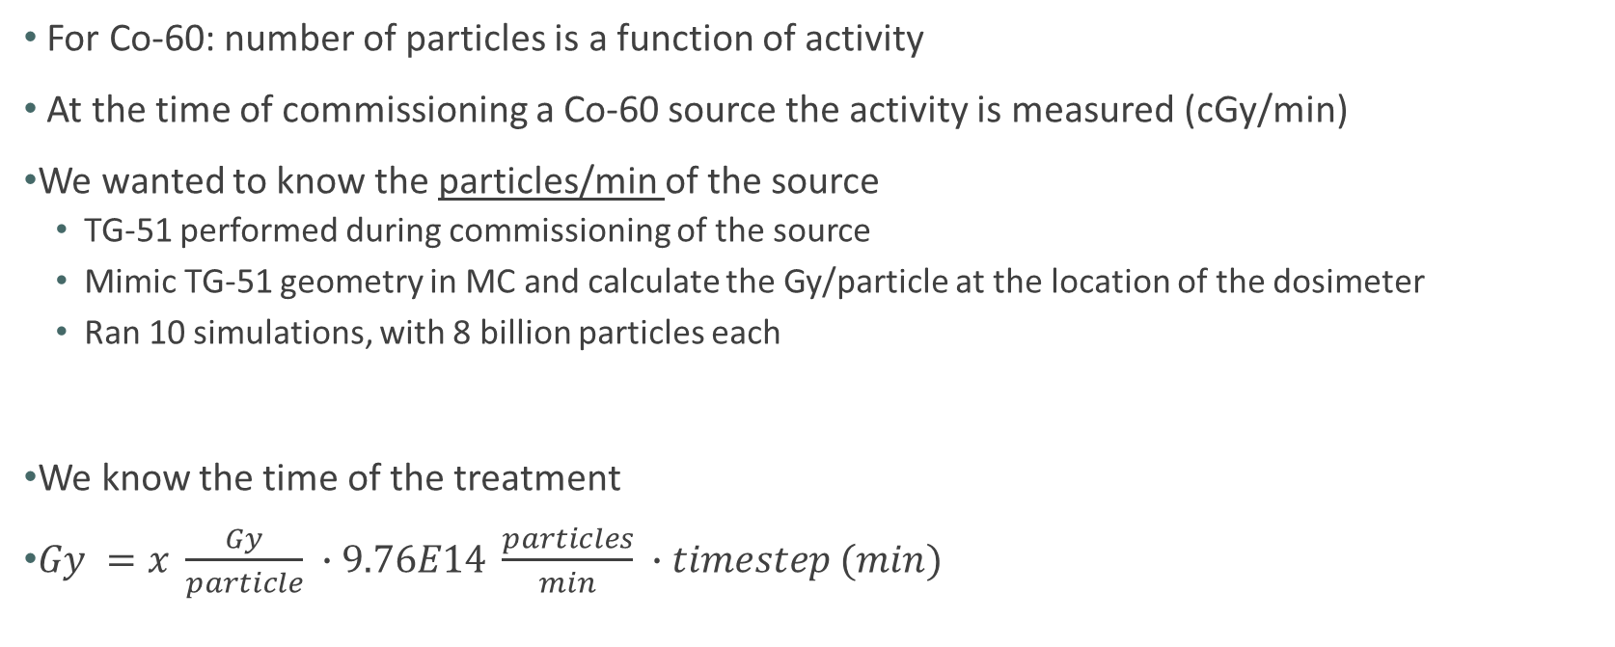
Converting Data: Gy/Particle to Gy
For Co-60: number of particles is a function of activity
At the time of commissioning a Co-60 source the activity is measured (cGy/min)
We wanted to know the particles/min of the source
TG-51 performed during commissioning of the source
Mimic TG-51 geometry in MC and calculate the Gy/particle at the location of the dosimeter
Ran 10 simulations, with 8 billion particles each
We know the time of the treatment
$Gy =x \frac{Gy}{particle} ∙9.76E14 \frac{particles}{min} ∙timestep (min)$
9.76 E 14 particles per minute
Burns, L., Teke, T., Popescu, I. A., & Duzenli, C. (2019). Monte Carlo Dosimetry of Organ Doses from a Sweeping-Beam Total Body Irradiation Technique: Feasibility and First Results. In L. Lhotska, L. Sukupova, I. Lacković, & G. S. Ibbott (Eds.), World Congress on Medical Physics and Biomedical Engineering 2018 (pp. 421–427). Springer.
Notes:
Uncert 0.4%, ran 10 sims

Slide 32
How we pull dose to voxel
Converted 4DMC Results
Dose (Gy), Voxel Index, Time of Event (sec)
Blood Flow Tracking Simulation

Slide 33
How we pull dose to voxel
Converted 4DMC Results
Dose (Gy), Voxel Index, Time of Event (sec)
Converted 4DMC Results
Dose (Gy/Particle), Voxel Index, Time of Event (sec)
Blood Flow Tracking Simulation
Per time step per blood voxel:
Location:
Position along length of the vessel
Voxel location
Mapped

Slide 34
How we pull dose to voxel
Converted 4DMC Results
Dose (Gy), Voxel Index, Time of Event (sec)
Converted 4DMC Results
Dose (Gy/Particle), Voxel Index, Time of Event (sec)
Blood Flow Tracking Simulation
Per time step per blood voxel:
Location:
Position along length of the vessel
Voxel location
Time within the simulation
Mapped

Slide 35
How we pull dose to voxel
Converted 4DMC Results
Dose (Gy), Voxel Index, Time of Event (sec)
Converted 4DMC Results
Dose (Gy/Particle), Voxel Index, Time of Event (sec)
Blood Flow Tracking Simulation
Per time step per blood voxel:
Location:
Position along length of the vessel
Voxel location
Time within the simulation
Dose to voxel (Gy)
Mapped

Slide 36
Next Steps: Dose to Compartments
Goal: Be able to sample the dose to the organ compartments
Note: Electing to ignore the distributed tissue compartments due to uncertainty in contouring
Common solution within the literature is to sample the Dose Rate Function per time step

Slide 37
Next Steps: Dose to Compartments
Goal: Be able to sample the dose to the organ compartments
Note: Electing to ignore the distributed tissue compartments due to uncertainty in contouring
Common solution within the literature is to sample the Dose Rate Function per time step
Issue: Sampling the DVH for dose ignores the times when the organ is outside of the field.
Potential Solution:
Determine organ-specific dose rates using 4D MC

Slide 38
Next Steps: Dose to Compartments
Issue: Sampling the 3D DVH for dose ignores the times when the organ is outside of the field.
Potential Solution:
Determine organ-specific dose rates using 4D MC.
Normalize number of events over the course of the treatment by the total number of events

Slide 39
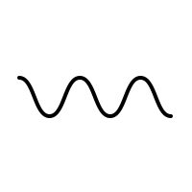
Next Steps: Dose to Compartments
Issue: Sampling the 3D DVH for dose ignores the times when the organ is outside of the field.
Potential Solution:
Determine organ-specific dose rates using 4D MC.
Normalize number of events over the course of the treatment by the total number of events
Event Frequency (1/s)
Time (s)

Slide 40
Next Steps: Dose to Compartments
Issue: Sampling the 3D DVH for dose ignores the times when the organ is outside of the field.
Potential Solution:
Determine organ-specific dose rates using 4D MC.
Normalize number of events over the course of the treatment by the total number of events
$$Dose= Sampled Dose \left(Gy\right)∗Event Frequency \left(\frac{1}{s}\right)∗∆t (s)$$
Dose (Gy)
Event Frequency (1/s)
Random Number [0,1]
Time (s)

Slide 41
What is the heterogeneity of dose to the circulating blood volume during TBI?
Presented at COMP 2025
Determine dose deposition in time
Track blood flow through the body
Model various TBI treatments

Slide 42
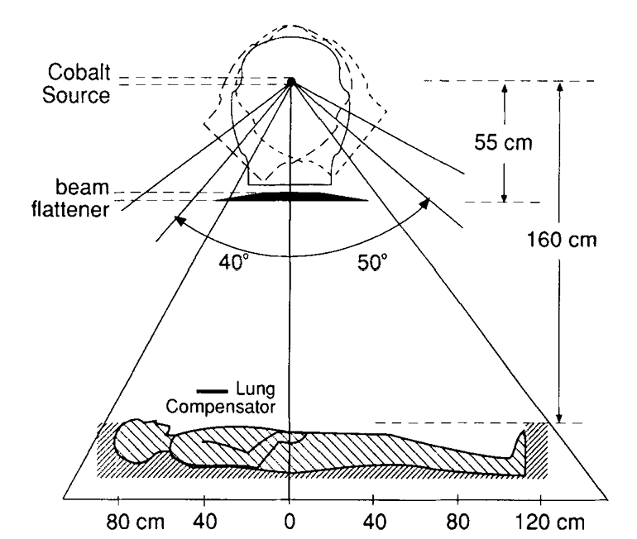
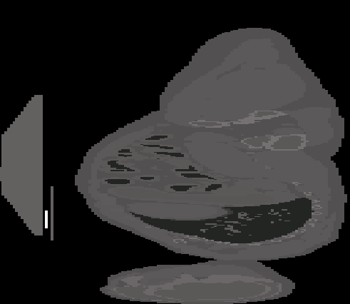
Sweeping Co-60
S. Hussein and E. el-Khatib, “Total body irradiation with a sweeping 60Cobalt beam,” Int J Radiat Oncol Biol Phys, vol. 33, no. 2, pp. 493–497, Sept. 1995, doi: 10.1016/0360-3016(95)00164-T.

Slide 43
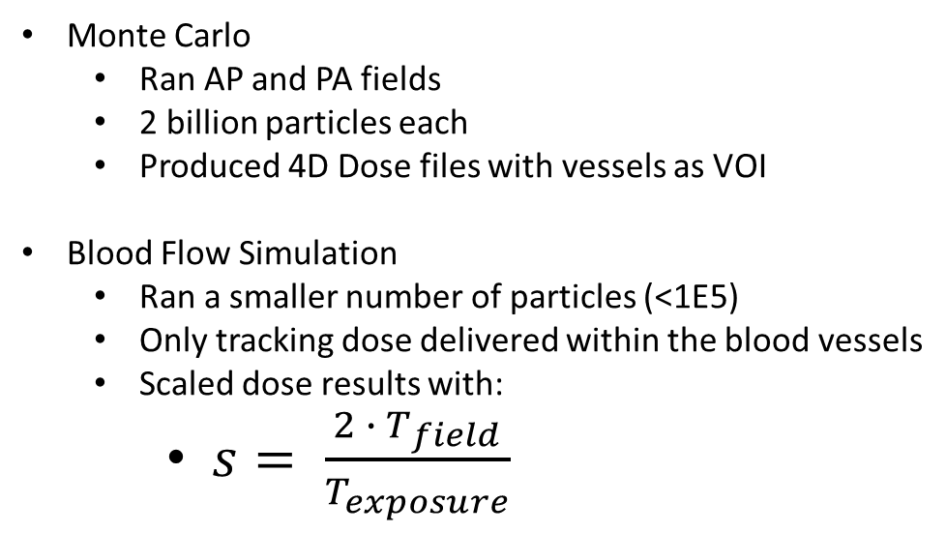
Prelim Dose Results
Monte Carlo
Ran AP and PA fields
2 billion particles each
Produced 4D Dose files with vessels as VOI
Blood Flow Simulation
Ran a smaller number of particles (<1E5)
Only tracking dose delivered within the blood vessels
Scaled dose results with:
$s= \frac{2 ∙ T_{field}}{T_{exposure}}$
Number of Blood Volumes | 500
Time step size (s) | 0.002
Time to Steady State (s) | 382
Delivery per Field (s) | 408.6
Time to “Flip” Patient (s) | 900

Slide 44
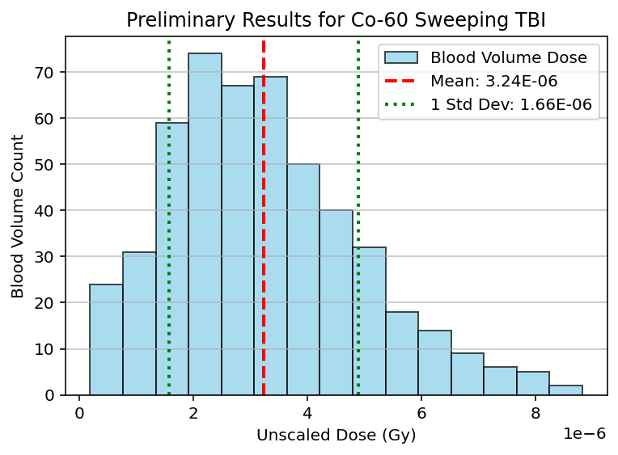
Prelim Dose Results: Unscaled
Monte Carlo
Ran AP and PA fields
2 billion particles each
Produced 4D Dose files with vessels as VOI
Blood Flow Simulation
Ran a smaller number of particles (<1E5)
Only tracking dose delivered within the blood vessels
Scaled dose results with:
$s= \frac{2 ∙ T_{field}}{T_{exposure}}$
Number of Blood Volumes | 500
Time step size (s) | 0.002
Time to Steady State (s) | 382
Delivery per Field (s) | 408.6
Time to “Flip” Patient (s) | 900

Slide 45
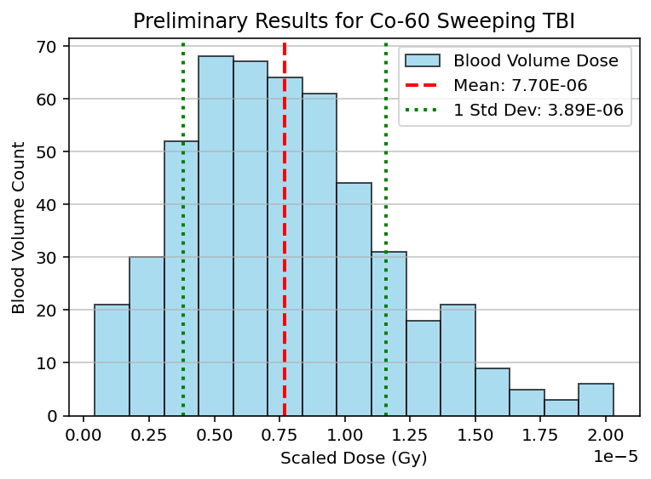
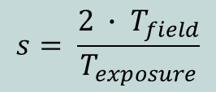
Prelim Dose Results: Scaled
Monte Carlo
Ran AP and PA fields
2 billion particles each
Produced 4D Dose files with vessels as VOI
Blood Flow Simulation
Ran a smaller number of particles (<1E5)
Only tracking dose delivered within the blood vessels
Scaled dose results with:
$s= \frac{2 ∙ T_{field}}{T_{exposure}}$
$$s= \frac{2 ∙ T_{field}}{T_{exposure}}$$
Number of Blood Volumes | 500
Time step size (s) | 0.002
Time to Steady State (s) | 382
Delivery per Field (s) | 408.6
Time to “Flip” Patient (s) | 900

Slide 46
Prelim Dose Results

Slide 47
Anticipating Projects 3
Model the following:
Extended POP: most common in Canada as of 2017
TBI VMAT: as delivered at BC Cancer – Vancouver
Q: Are their variables we can vary during the treatment planning process?
Compare the standard deviation of the dose to the BVs for all treatments
R. C. N. Studinski, D. J. Fraser, R. S. Samant, and M. S. MacPherson, “Current practice in total-body irradiation: results of a Canada-wide survey,” Curr Oncol, vol. 24, no. 3, pp. 181–186, June 2017.

Slide 48
Publications Anticipated and Issues
Submitted Project 1 – Blood Flow Model to Physics in Medicine & Biology and the paper was rejected.
The lack of dosimetric results was a significant piece of feedback.

Slide 49
Publications Anticipated and Issues
Submitted Project 1 – Blood Flow Model to Physics in Medicine & Biology and the paper was rejected.
The lack of dosimetric results was a significant piece of feedback.
Options:
Re-submit with additional focus on validation metrics
Combine Project 1 and Project 2 into a singular publication

Slide 50
Big Question: Do you feel like the outlined work meets the requirement to fill the body of my thesis?

Slide 51
Thank you.
Questions for you:
Thoughts on publication issue?
Thoughts on work and future work constituting a full thesis?
Questions for me?

Slide 52
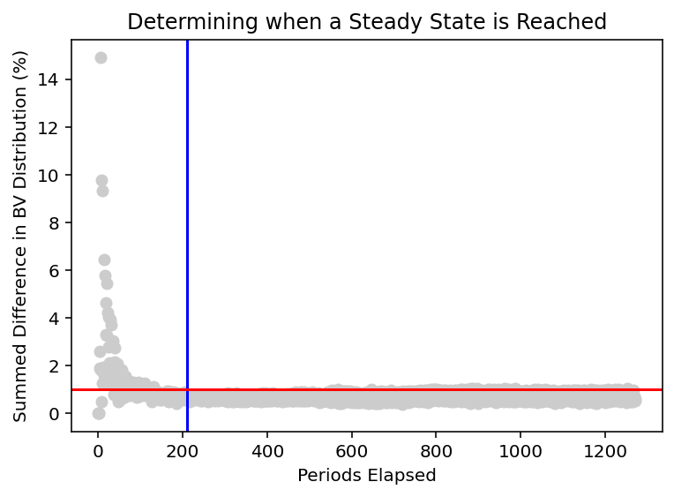
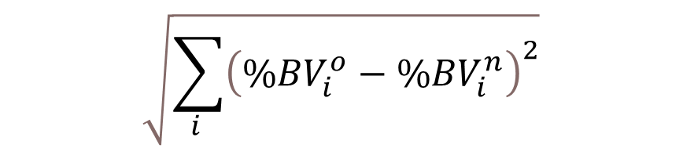
Steady State Identification
All Blood Voxels Released
1%
$$\sqrt{\sum_{i }{{\left({\%BV}_{i}^{o}−{\%BV}_{i}^{n}\right)}^{2}}}$$

Slide 53

Model Components – Systemic Veins
Doppler ultrasound and MRI flowrate data
$$Q\left(0\right)= {Q(L)}_{a}+{Q(L)}_{b}$$
Notes:
1D modelling, what is it, how are vessels connected to each other, how does bv move down the vessels starting at the heart.

Slide 54
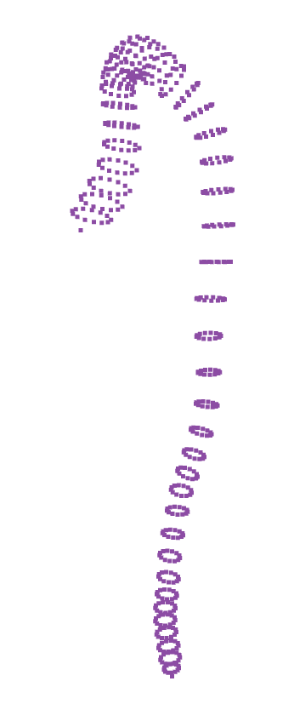
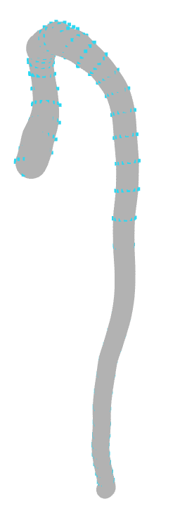
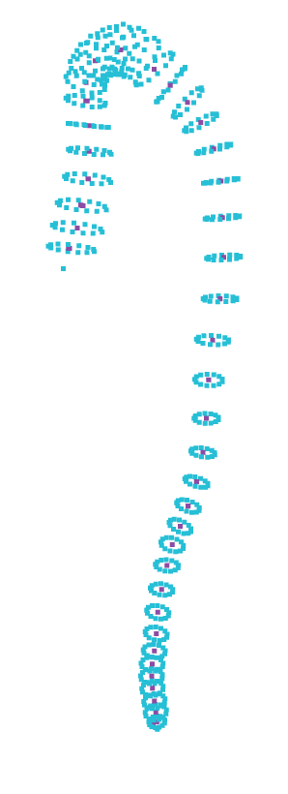
Dimension Extraction
Superior Mesenteric Artery
Calculated length (N =12)
$\overline{L}=220.84 mm ±0.33 \%$
Manually measured length
$L=212.75$ mm
Hemolab Value:
$L=216.79$ mm
Calculated radius (N = 12)
$R_{u}=1.79 mm ±2.79 \%$
$R_{d}=1.66 mm±18.67 \%$
Jin, Young-Hoon, and Won-Hyung Lee. “Fast cylinder shape matching using random sample consensus in large Scale Point Cloud.” Applied Sciences, 9, 5, 2019.
Watanabe, Sansuke M., Blanco, Pablo J., and Feijóo, Raúl A.. "Mathematical Model of Blood Flow in an Anatomically Detailed Arterial Network of the Arm." ESAIM: Mathematical Modelling and Numerical Analysis - Modélisation Mathématique et Analyse Numérique 47, 4, 2013.

Slide 55
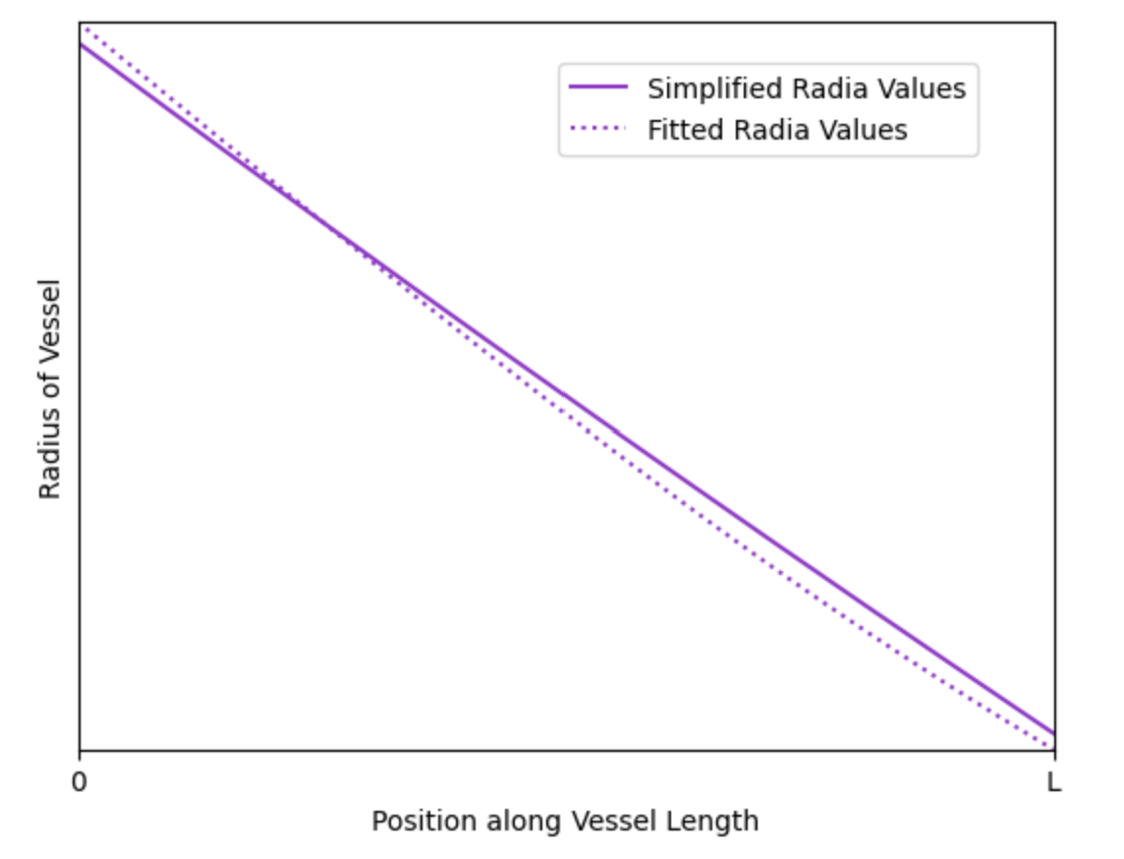
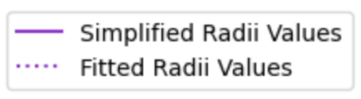
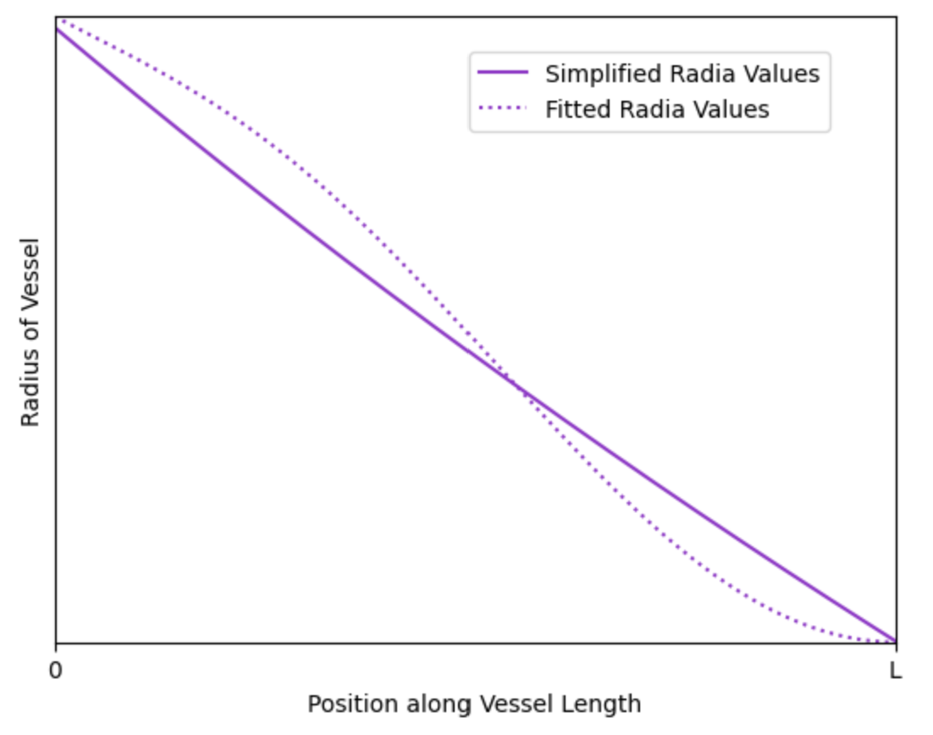
Network and Simplifications
$$R \left(x\right)=R_{u} {\frac{R_{d}}{R_{u}}}^{\frac{x}{L}}$$
Olufsen, Mette Sofie. “Structured tree outflow condition for blood flow in larger systemic arteries.” American journal of physiology. Heart and circulatory physiology , 276, 1, 1999.

